Slide 1
America's Wonderland Party
Fabian Lemus
Period 2 Jan. 20, 2017

Slide 2
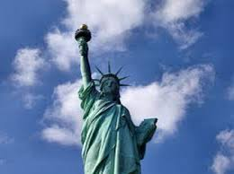
America’s Wonderland Party
“No need to fear, American’s to the rescue!”

Slide 3
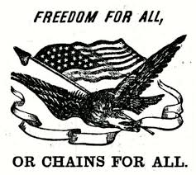
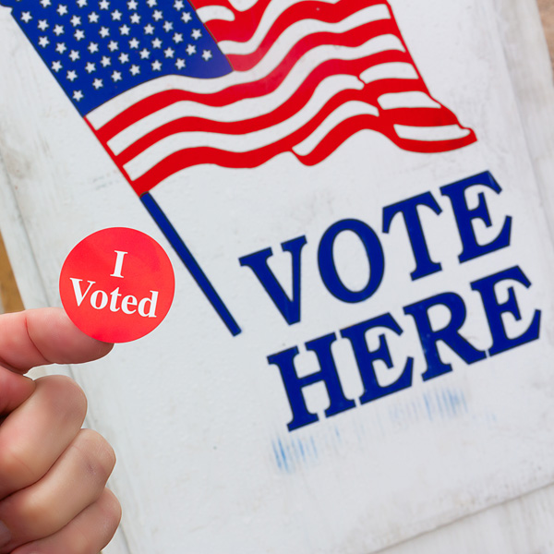
Our Mission Statement
Freedom for all or freedom for none!
Use and adjust to worlds new advancements!
Citizens make up the government!

Slide 4
Jobs and the Economy
We will create thousands of jobs for everyone in order to help out the economy. No American should be suffering because they can’t find a job. We will expose jobs out there to the public in order for homeless people and people with no resources to be able to find a job and start a new life. There will be a variety of jobs for every type of person, high education, little education, and no education. Yes, everyone’s salary will be different but everyone works for what they want. If someone wants a higher salary they will have to have higher education or better skills. We will also make minimum wage be $12; however this will also make prices go up but we won’t allow prices to rise much. The way that we will handle taxes will depend on the amount of money you earned yearly.

Slide 5
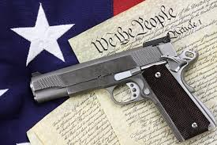
Gun Control
We have all heard of gun control. America’s Wonderland Party will do the best when it comes to gun control. We will allow citizens to consume guns. However, each and every of those citizens trying to purchase a gun will be looked into very closely. They will have to wait about a week while they do a complete background check on the person trying to purchase a gun. There will be very high expectations and they will be extremely strict on everyone's background check, so if the person should not have access to a gun they will not be able to have one. America’s Wonderland Party does not know why some say ban guns. We believe that if you ban guns from everyone that would put the good citizens at risk because no matter what a few bad people will always find a way to get have access to guns so that way other citizens can protect themselves from that type of harm or anything else.

Slide 6
Immigration
America’s Wonderland Party will also take action on immigration. We believe that the United States needs to be a diverse place with people from everywhere around the world. We will allow people to migrate into our country and stay here. America’s Wonderland Party also believes that immigrants have made a great impact on our country and we can not restrict them from being here. Yes not all immigrants might be a help to our country but there will always be bad and good people from every location. We can’t let the few ruin it for everyone; instead we will have all immigrants go through a process to investigate them to make sure they won’t harm our country instead of benefit it.

Slide 7
Education
America’s Wonderland Party will also take care of issues related to education. We will make sure that every student has the opportunity to get high quality education. We want our future to be greater than now so we need to teach the younger generation everything they need to know. If we want to change the United States, America’s Wonderland Party believes that we need to change education and hold teachers and students to higher standards. Students are the heart of our future, so that makes it very important to us. We do not want to have a generation of dummies, we want to have a generation of successful well educated people that will completely transform and better the United States. We will strike down on the content students are learning at school and make adjustments as needed.

Slide 8
Crime and Violence
Crime and violence is another issue that America’s Wonderland Party would attack. We will decrease the crime and violence that people see on a daily basis. We know that we cannot completely get rid of that but we will definitely decrease it. We will make stricter laws so that people will think more about doing a crime therefore having less crime. America’s Wonderland Party will also hire more police officers which creates more jobs for people and keeps everyone safer. No American should be scared to go out of their house because of certain crime or violence going on. We will make the United States a more peaceful place for everyone and will continue to come down on crime and violence and put an end to it.

Slide 9
Abortion
We, America’s Wonderland Party takes abortion very serious serious. We believe that every single person deserves to live life. Abortion is killing the lives of innocent babies that do not want to be dead. America’s Wonderland party believes that if you do not want to have a child to use birth control or some sort of protection instead of killing babies once they are already forming and or formed. No one should be forced to die, god gave us a life and we have to value everyone’s life that was given to them. Stop abortion now! Just like no one killed you when you were in the process of being born, you shouldn’t kill others. Some American’s wish they could have children but they aren't fortunate enough to be able to. So America’s Wonderland Party will completely stop abortion and help out these innocent babies.

Slide 10
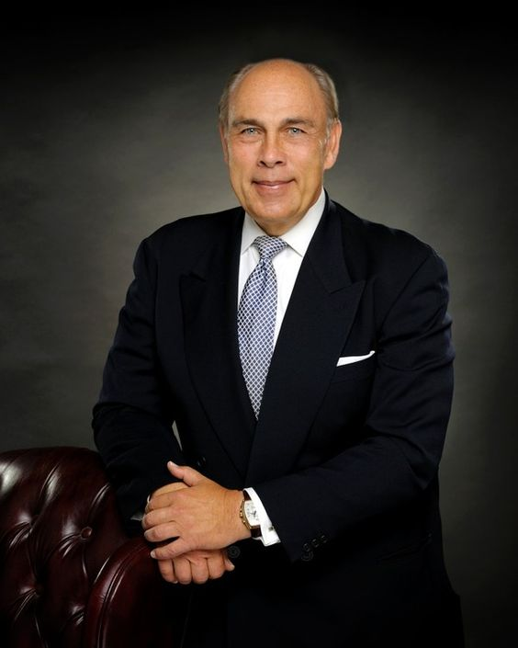
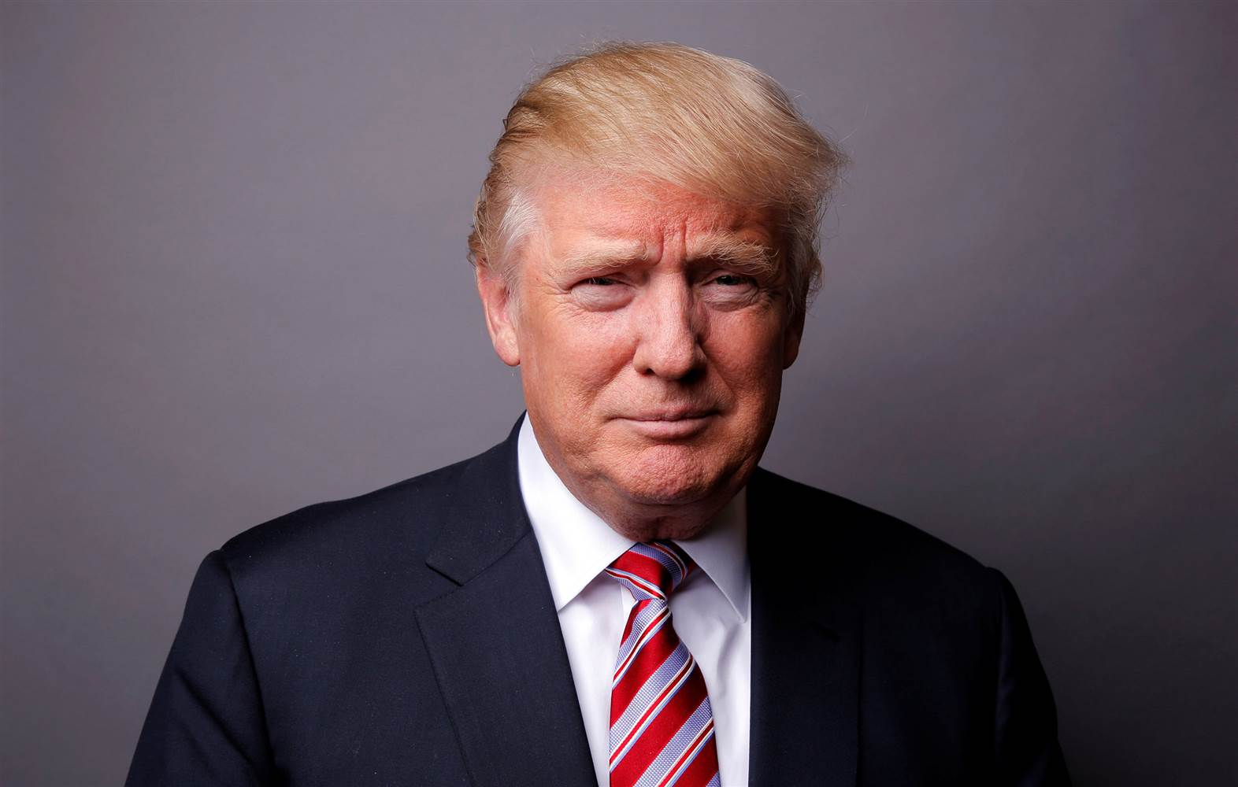
Why America’s Wonderland Party?
America’s Wonderland Party |  | Republicans Under Trump
We believe that America should allow foreign trade with other countries around the world. | America’s Role in the World | Republicans would endanger America’s role as a world leader
We believe that every American should be able to have a job and grow economically. | Jobs & the Economy | Republicans would start trade wars that would harm the economy
We strongly encourage citizens to get highly involved with everything to limit the government's power. | Constitutional Balance | Republicans would give too much power to the Executive Branch

Slide 11
Level 4:

Slide 12
Opinion Survey
Issue: | Strongly Agree | Agree | Disagree | Strongly Disagree
Jobs and the Economy | 5 | 16 | 1 | 1
Gun Control | 9 | 10 | 2 | 2
Immigration | 10 | 13 | 0 | 0
Education | 11 | 12 | 0 | 0
Crime and Violence | 8 | 13 | 2 | 0
Abortion | 7 | 10 | 3 | 3
Link to survey: https://goo.gl/forms/ifdb5zHYWe4hZrM82

Slide 13
Campaign Poster

