Slide 1
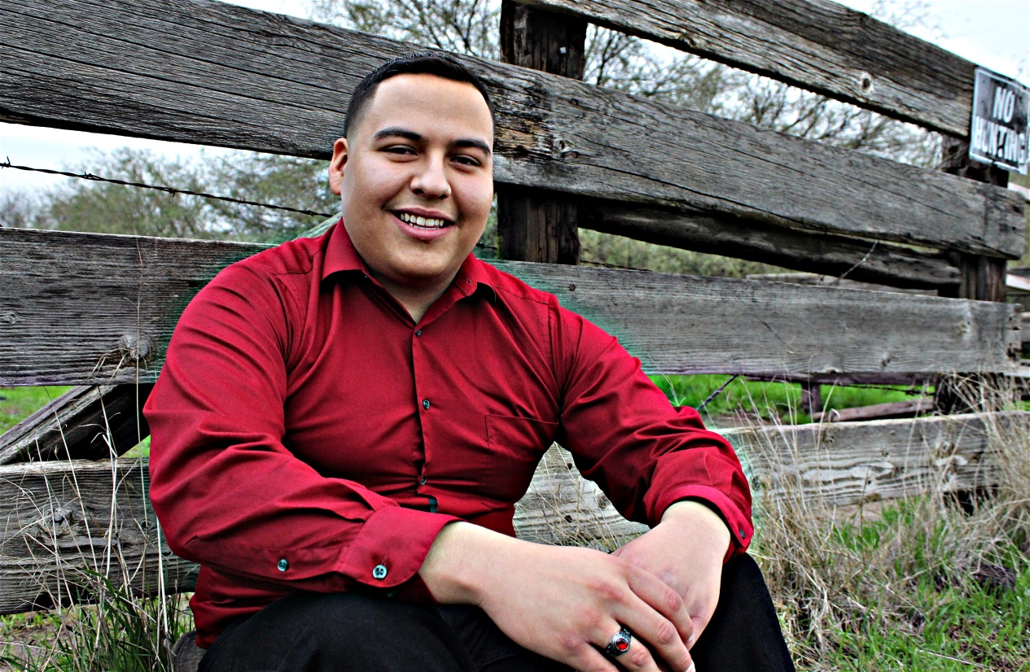
Fabian Lemus Martinez

Slide 2
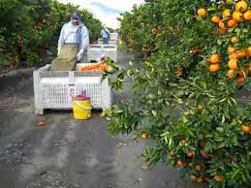
About me
Born in Mexico
01/20/1999
Middle child (7)
Green-favorite color
Very friendly, organized, over achiever
Working in the fields
Part time job at STARS Program

Slide 3
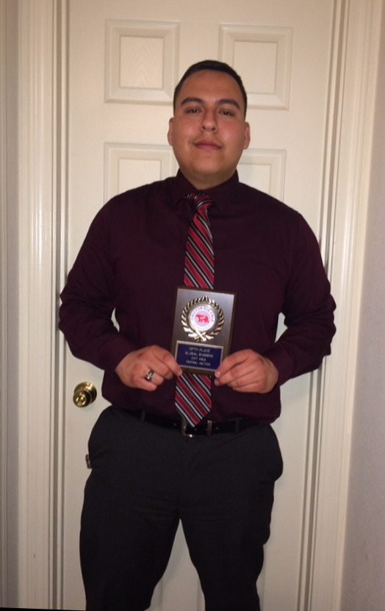
High School Experiences
Clubs & Activities
Challenges & Successes
AVID
Key Club
FBLA
REAP
NSHS
My Strength
Migrant Program
Leadership (ASB)
Challenges
Adjusting to changes
Managing my time
Successes
Successful independent student (PBS)
Communication
GPA: 3.70 Rank: 17
Graduating with AVID and Spanish Honors

Slide 4
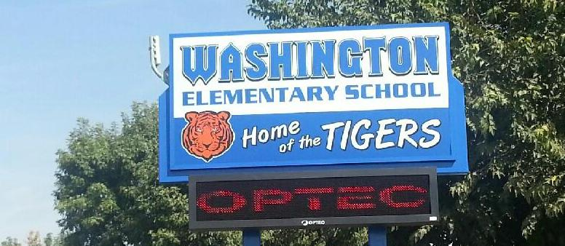
Job shadow
Elementary 5th grade teacher
Mr. Gonzalez (Washington Elementary School)
My career (Elementary Teacher)
Interesting (Students Learning)
Memorable moment (Substitute Teacher)
Make a change
Help others

Slide 5
Pathway
Spanish Speakers Pathway
Spanish Speakers 1
Spanish Speakers 2
AP Spanish Language
Become fluent in my first language
Taught me improvement
Relates to my future career
Bilingual teacher
Use in real word (Lifetime)

Slide 6
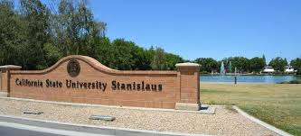
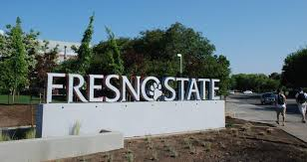
Post-high school plans
I am going to move to Fresno or Turlock California
I will be attending CSU Fresno or Stanislaus
Liberal Studies Major
I have received four letters of acceptance
Fresno State, Sacramento State, San Jose State, & Stanislaus
Why Fresno and Stanislaus?
No family financial support
Scholarships
Bachelors and Masters degree
Teaching credentials

Slide 7
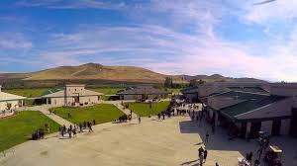
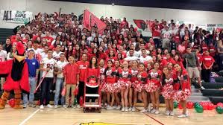
Leaving LHS
LHS has been a great experience for me.
Mr. Guss has inspired me that anything is possible.
The PBS system has taught me…
Determined
Independent

Slide 8
QUESTIONS?
Thank you for your time and attention!

